Slide 1



Domain Adaptation in Breast Cancer Classification
Autor: Christian Queralt Aixendri
Director: Dr. Kaisar Kushibar
Developed in: Mathematics and Computer Science department

Slide 2
Presentation Agenda
INTRODUCTION
Breast Cancer Statistics
Imaging Modalities for Breast Cancer Screening
Lesion Types
Role of AI & Use Case of my Model
Objectives of This Work
METHODOLOGY Datasets Overview Data Preprocessing Pipeline Model Architecture Evaluation Protocol
RESULTS In-Domain Performance (CBIS-DDSM & BCDR) Cross-Domain Transfer Results Transfer Learning: Fine-tuning Curves
CONCLUSIONS Summary Observations & Limitations
Future Work Ideas
1
2
3
4

Slide 3
INTRODUCTION METHODOLOGY RESULTS CONCLUSIONS
“We are really making a lot of progress in research, and treatment is very different today than it was even 10 years ago. It’s hard to predict where it will be 10 years from now, but I think breast cancer is going to be one of the first cancers where we’re going to be able to say that we’ve virtually eliminated mortality.”
—BCRF investigator Dr. Eric Winer
3/38

Slide 4
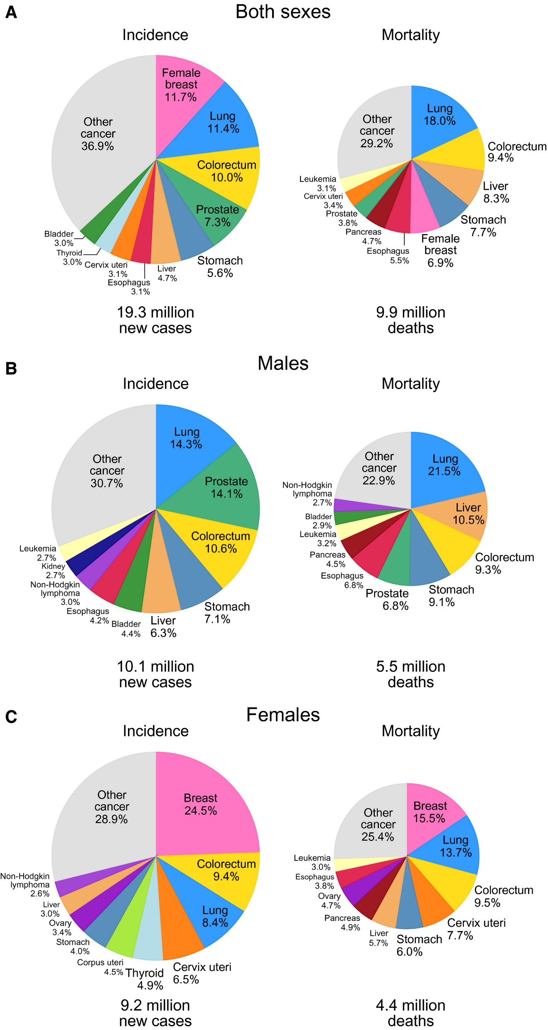

INTRODUCTION METHODOLOGY RESULTS CONCLUSIONS
Breast Cancer Statistics
Figure 1. Distribution of Cases and Deaths for the Top 10 Most Common Cancers in 2020 [1]
4/38

Slide 5
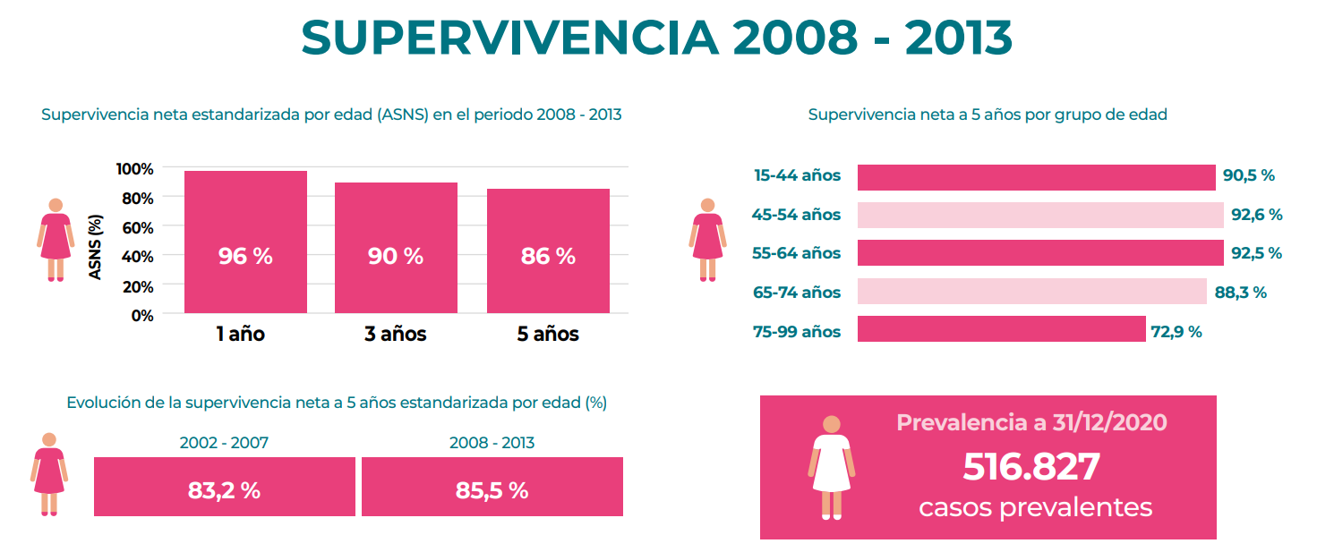
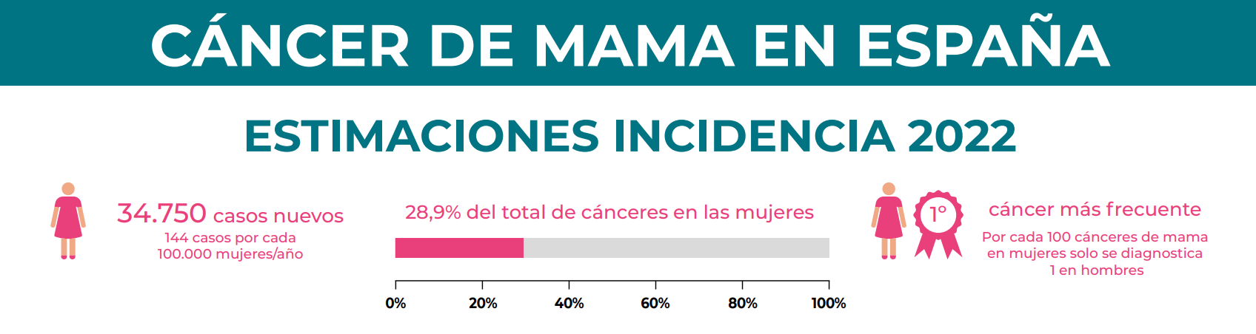
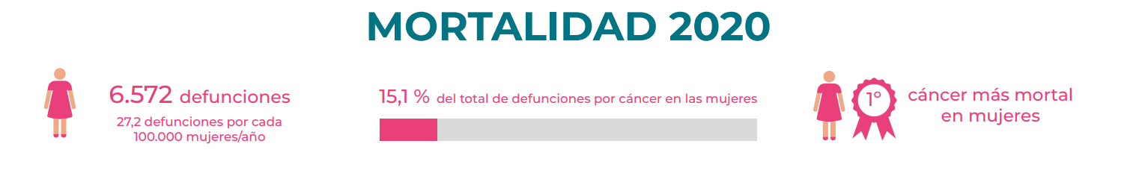
INTRODUCTION METHODOLOGY RESULTS CONCLUSIONS
Breast Cancer Statistics
Figure 2. Spain Statistics on Breast Cancer [2]
5/38

Slide 6
INTRODUCTION METHODOLOGY RESULTS CONCLUSIONS
Breast Cancer Statistics
SEER Stage | 5-year Relative Survival Rate
Localized* | >99%
Regional (Same Organ) | 87%
Distant (Metastasized) | 32%
All SEER stages combined | 91%
Table 1. 5-year relative survival rates for breast cancer [12]
6/38

Slide 7
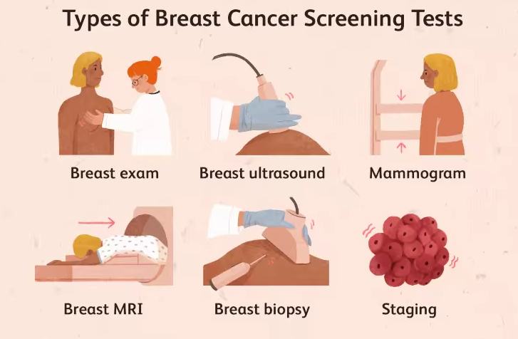
INTRODUCTION METHODOLOGY RESULTS CONCLUSIONS
Imaging Modalities for Breast Cancer
Screening Mammograms
Detect hidden cancers in asymptomatic women
Standard 2-view exam (CC + MLO) for routine early detection
Diagnostic Mammograms
Add targeted views and magnification to evaluate suspicious areas
Guide further workup when screening results are inconclusive
7/38
Figure 3: Types of Breast Cancer Screening Tests [3]

Slide 8
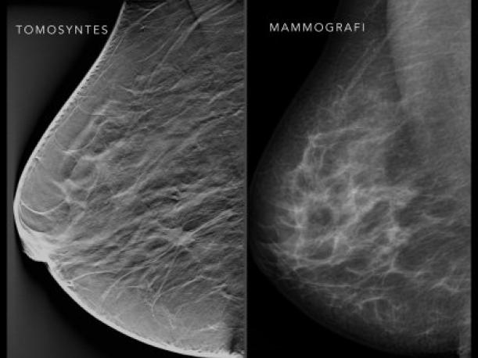
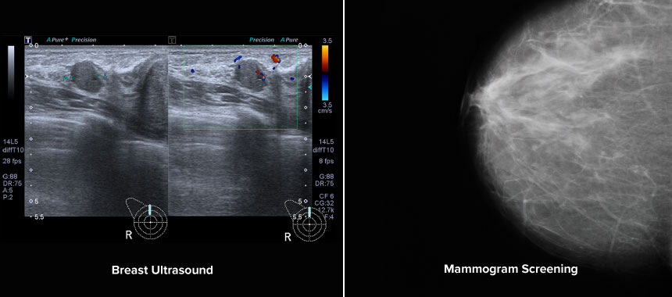
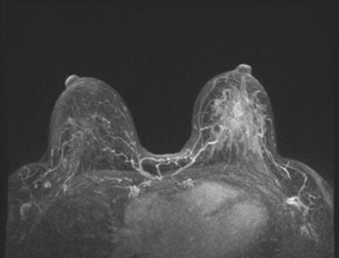
INTRODUCTION METHODOLOGY RESULTS CONCLUSIONS
Imaging Modalities for Breast Cancer
Digital Breast Tomosynthesis (DBT)
3D “slices” combined with 2D mammogram
Used to clarify overlapping tissue in dense breasts or equivocal findings [4]
Breast Ultrasound
Real-time sound-wave imaging, no radiation
Employed to characterize palpable lumps or follow up indeterminate mammogram areas [5]
Breast MRI
High-resolution contrast-enhanced scans
Reserved for high-risk screening (e.g., BRCA carriers) or staging known malignancies [6]
Figure 4. Tomosynthesis mammogram [4]
Figure 5. LCC ultrasound mammograms [5]
8/38
Figure 6. Breast cancer screening using MRI [6]

Slide 9
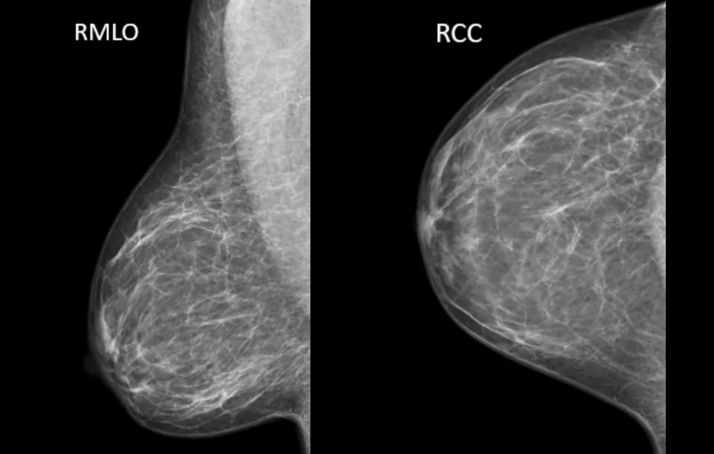
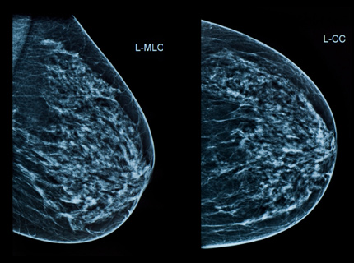
INTRODUCTION METHODOLOGY RESULTS CONCLUSIONS
Imaging Modalities for Breast Cancer
Screening Mammograms (Film):
X-ray captured on film; used where digital isn’t available
Requires precise compression and darkroom processing
Reliable detection but no digital post-processing or dose savings [7]
Digital Mammography:
X-ray → electronic signal → digital image
Enables advanced processing, PACS storage, and teleradiology
Lower dose (~3.7 mGy), higher resolution, better for dense/younger breasts
Figure 7. MLO and CC film mammograms [7]
Figure 8. MLO and CC digital mammograms
[8]
9/38

Slide 10
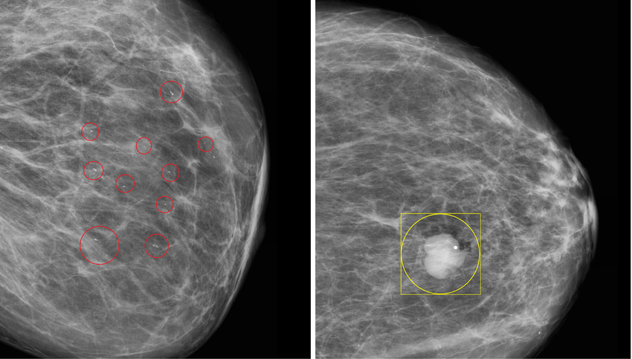
INTRODUCTION METHODOLOGY RESULTS CONCLUSIONS
Lesion Types
Calcifications:
Tiny calcium deposits within breast tissue that appear as bright spots on mammograms.
Masses:
Three-dimensional lesions that present as distinct areas of tissue density. [13]
Figure 9. Calcification and mass example [13]
10/38

Slide 11
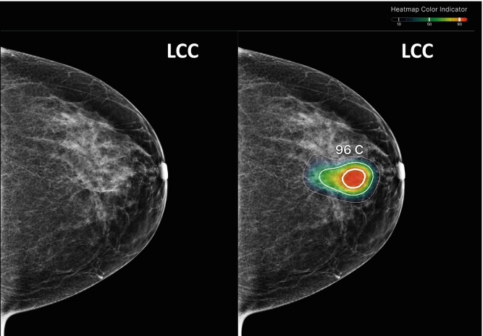
INTRODUCTION METHODOLOGY RESULTS CONCLUSIONS
Role of AI & Use Case of this Project
Role of AI in Breast Cancer Detection
Highlight suspicious regions and quantify tissue features
Predict malignancy risk as a second-reader check
Improve sensitivity, reduce false negatives, and standardize interpretations [9]
Figure 10. AI used to highlight tumor region [9]
11/38

Slide 12
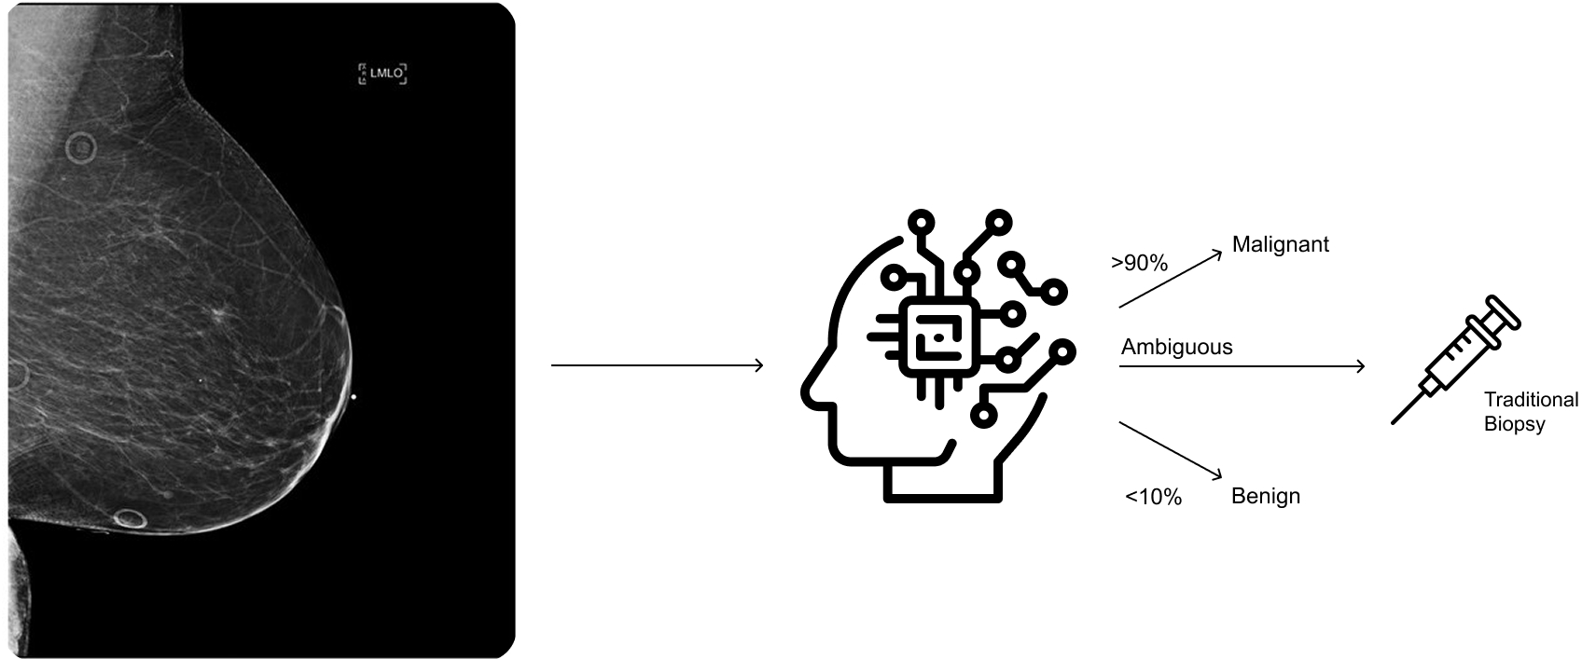
INTRODUCTION METHODOLOGY RESULTS CONCLUSIONS
Role of AI & Use Case of this Project
Use Case of this Project
Acts as a non-invasive “virtual biopsy” using deep learning
Estimates lesion pathology directly from mammograms
Guides clinical decisions and prioritizes patients for invasive biopsy
Figure 11. Use case of the project for classification
12/38

Slide 13
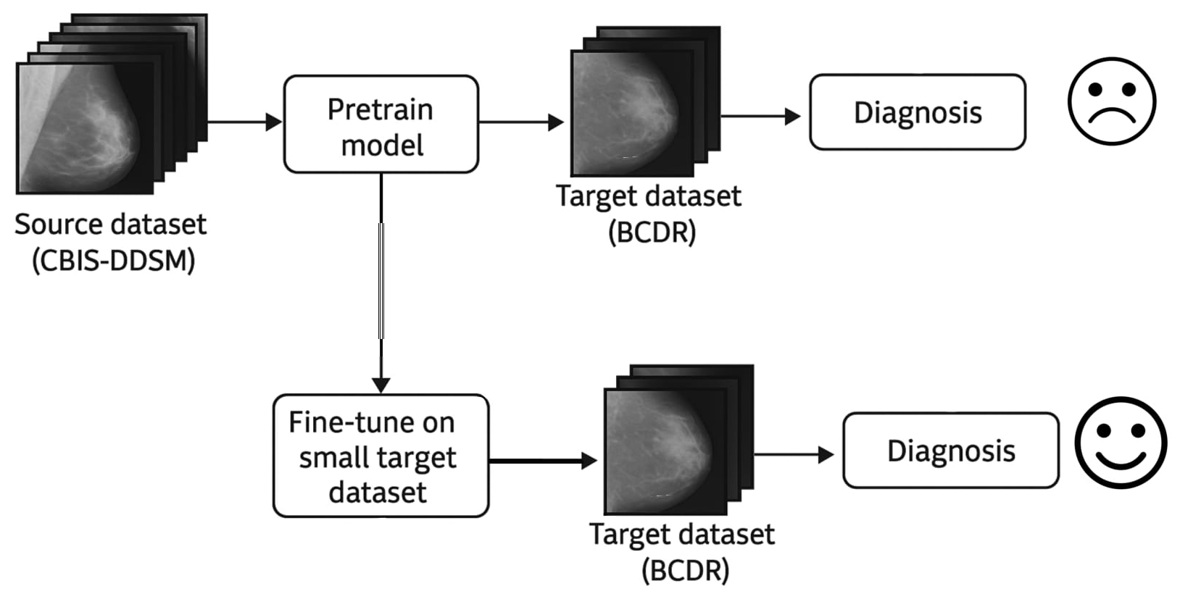
INTRODUCTION METHODOLOGY RESULTS CONCLUSIONS
Objectives of This Work
Assess ResNet-18 classifier’s performance across different mammography datasets
Integrate and harmonize CBIS-DDSM (source) and BCDR (target) data
Train on one domain and fine-tune on the other to measure transferability
Figure 12. Objective of this work
13/38

Slide 14
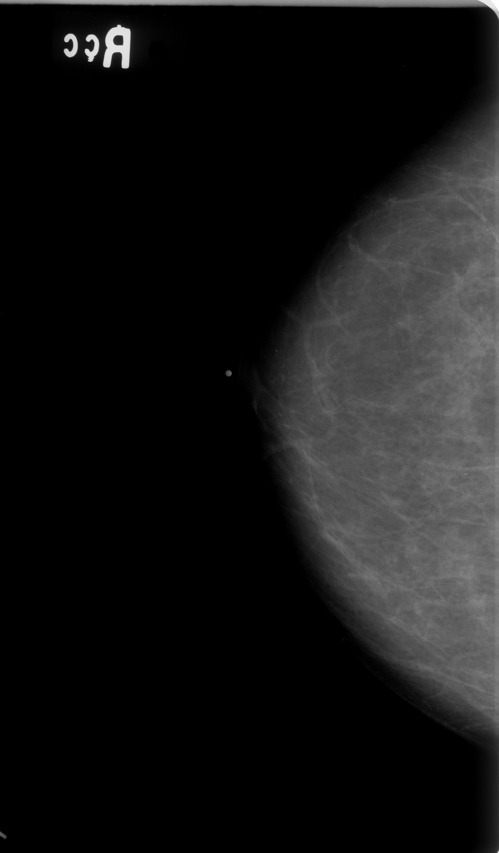
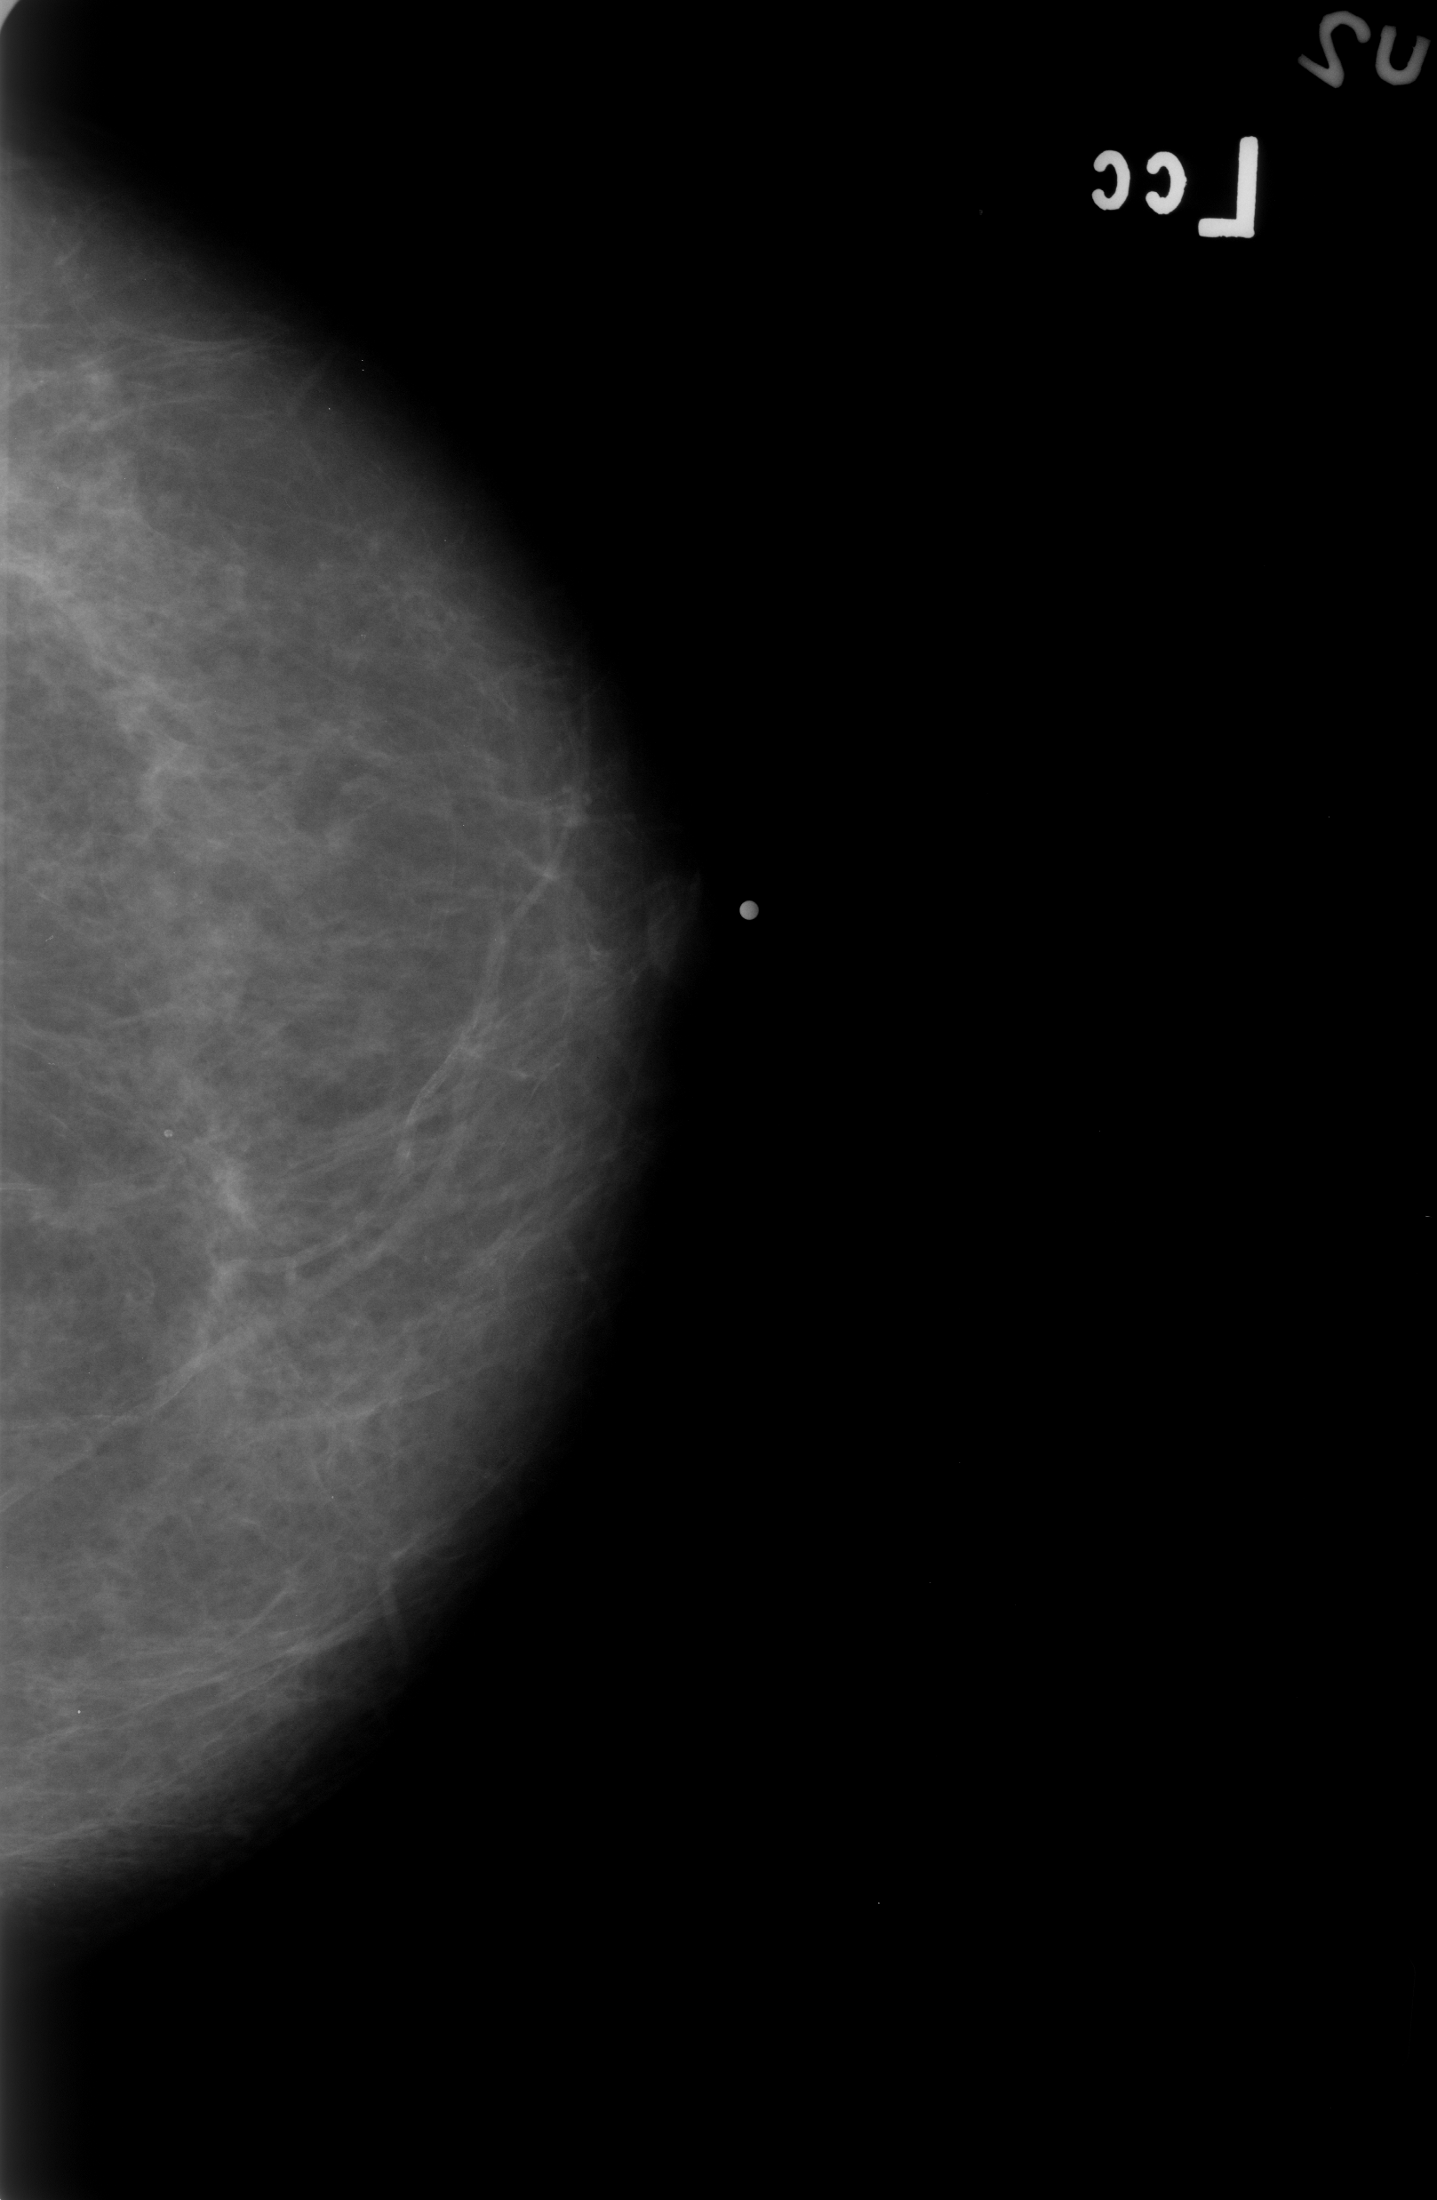
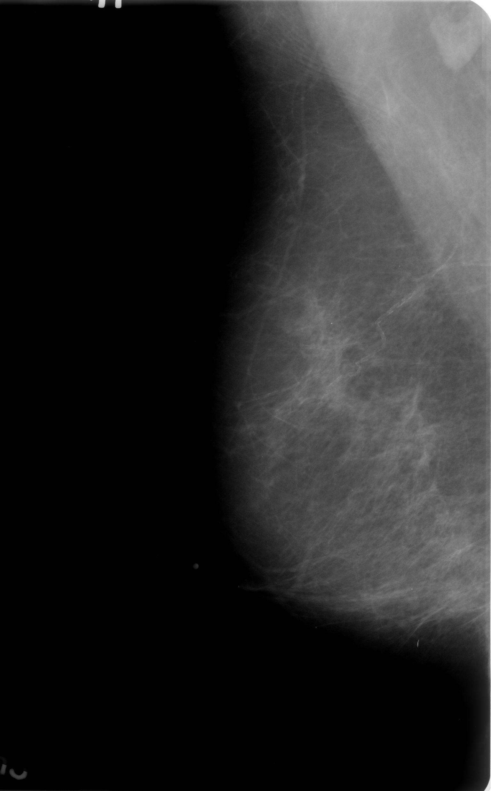
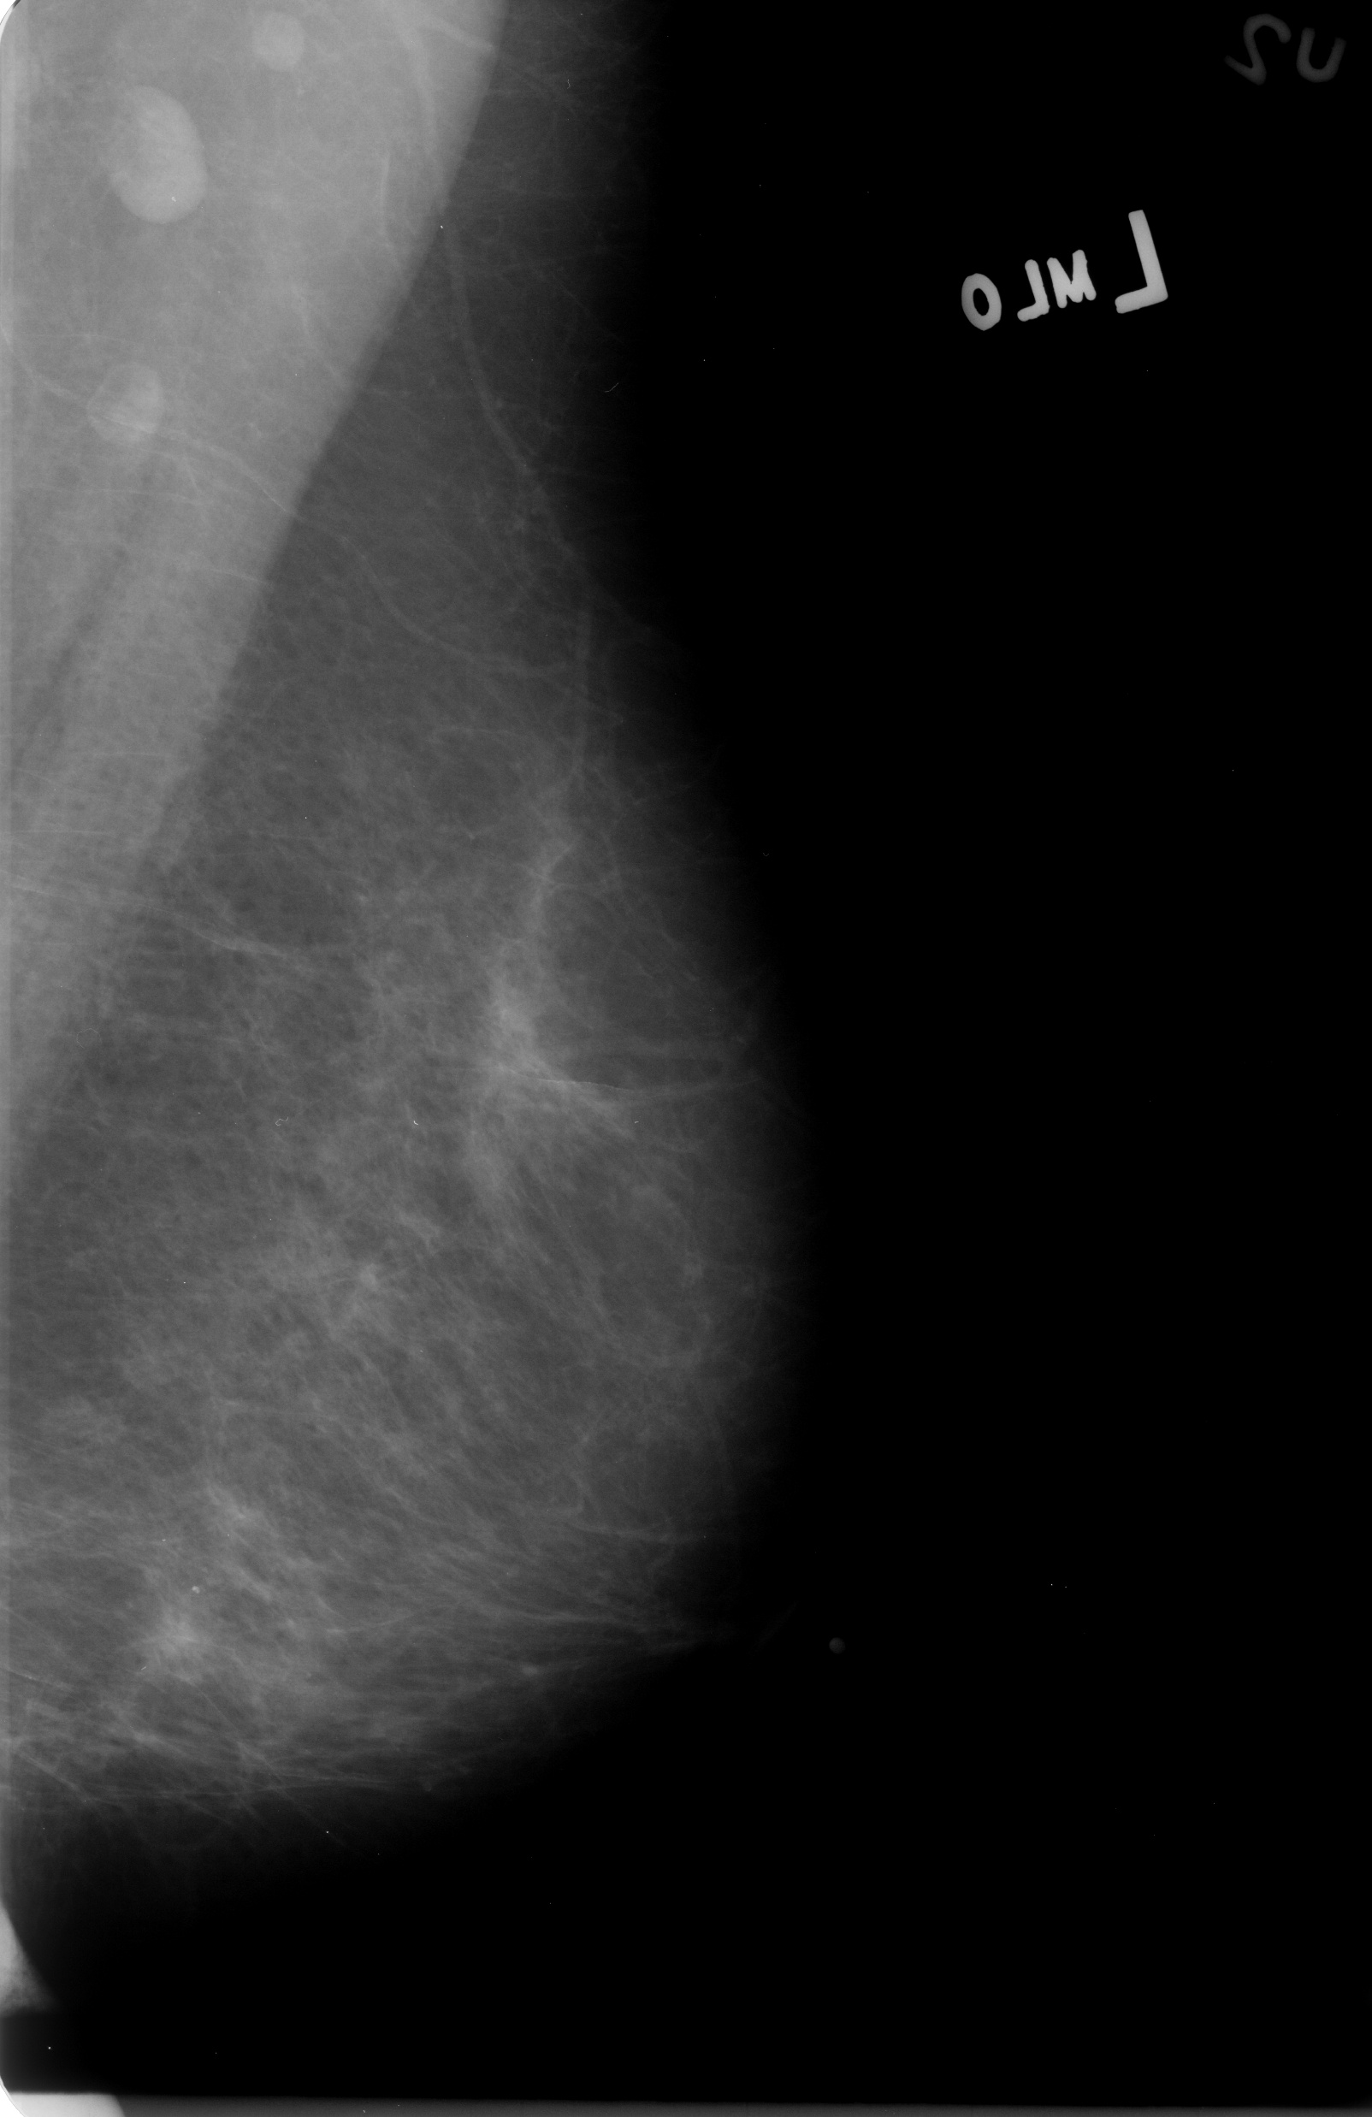
INTRODUCTION METHODOLOGY RESULTS CONCLUSIONS
Datasets Overview
Dataset | # Cases | Imaging Modality | Resolution | Annotations
CBIS-DDSM | ~3,100 | Scanned film mammography | Variable, lower dpi | Pixel-level masks (masses & calcs)
BCDR | ~1,000 | Full-field digital mammography | High dpi, uniform | Lesion metadata & clinical findings
Table 2. Comparison between used datasets
14/38
Figure 13. Some examples od CBIS-DDSM and BCDR mammograms

Slide 15
INTRODUCTION METHODOLOGY RESULTS CONCLUSIONS
Data Preprocessing Pipeline
CBIS-DDSM
15/38

Slide 16
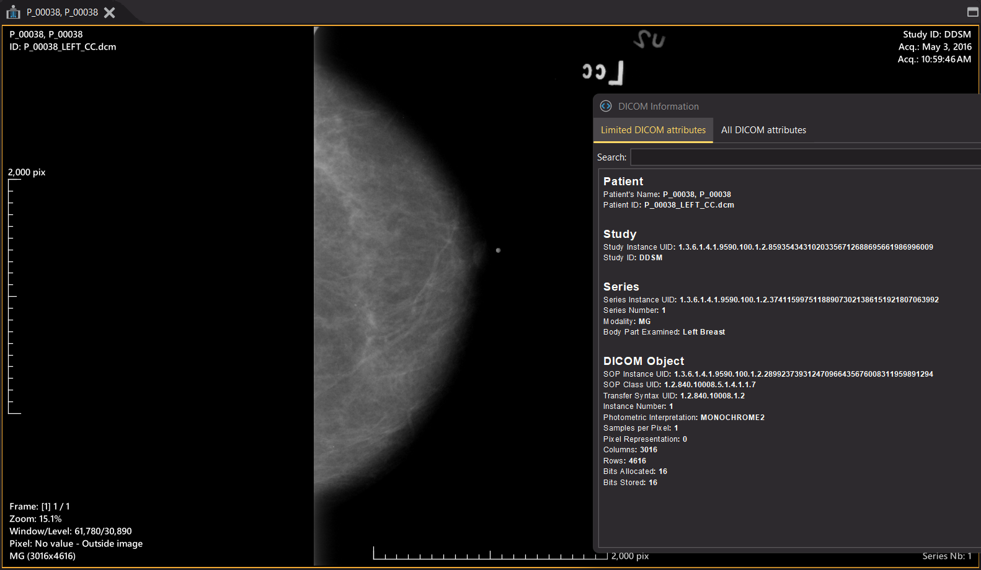
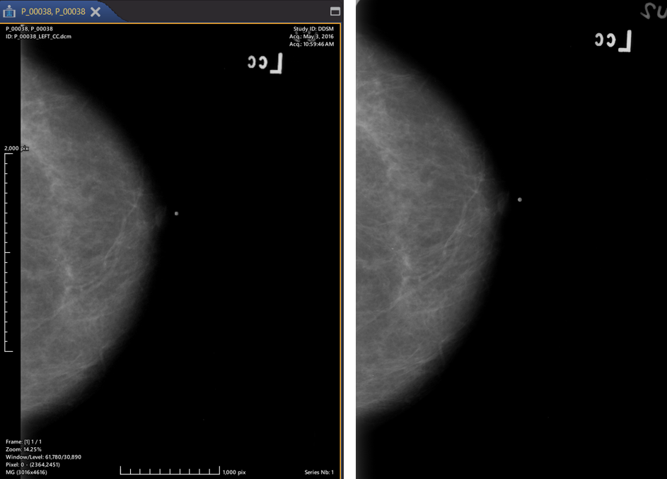
INTRODUCTION METHODOLOGY RESULTS CONCLUSIONS
Data Preprocessing Pipeline
.dcm
.png
Figure 14. CBIS-DDSM preprocessing process
16/38

Slide 17
INTRODUCTION METHODOLOGY RESULTS CONCLUSIONS
Data Preprocessing Pipeline
BCDR
17/38

Slide 18
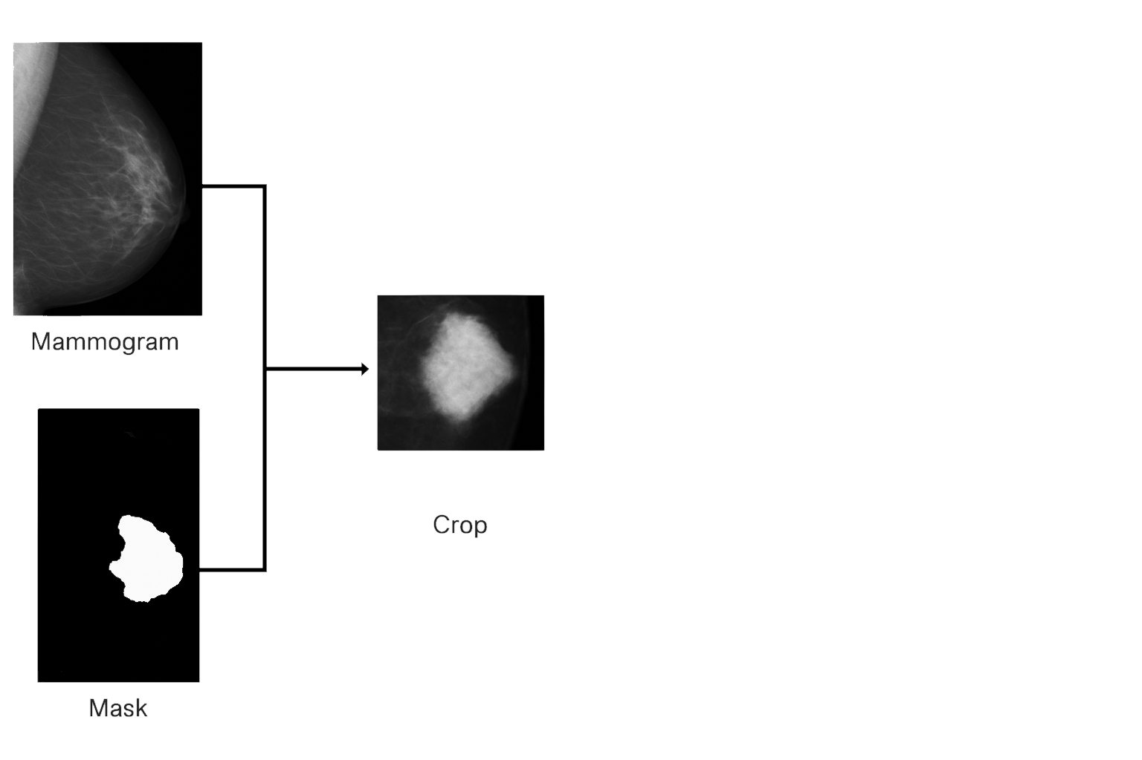
INTRODUCTION METHODOLOGY RESULTS CONCLUSIONS
Data Preprocessing Pipeline
.tif
.png
.tif
Figure 15. BCDR preprocessing process
18/38

Slide 19
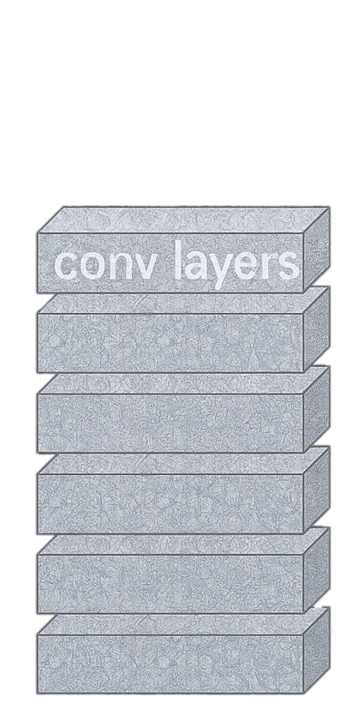
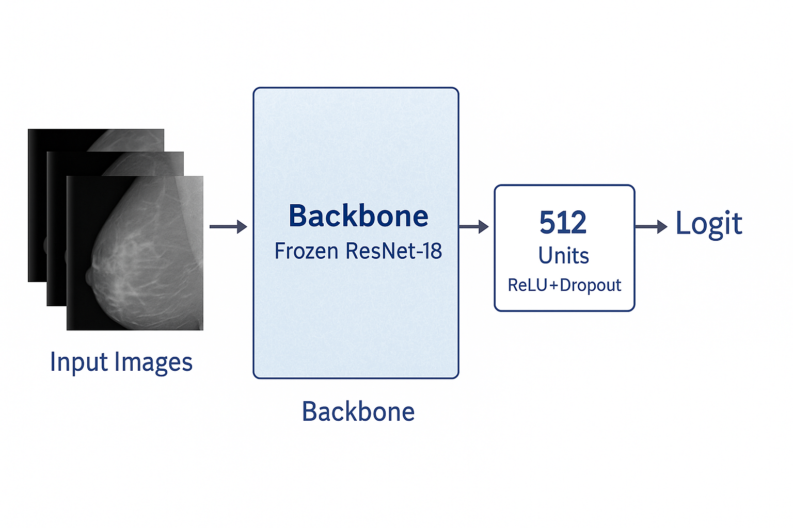
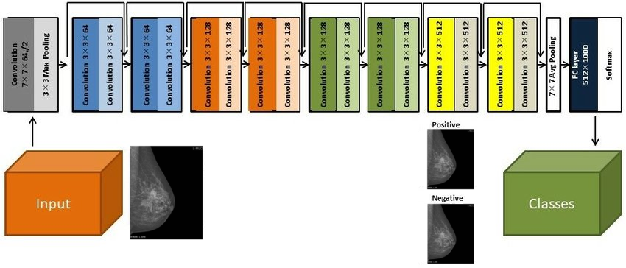
INTRODUCTION METHODOLOGY RESULTS CONCLUSIONS
Model Architecture
ResNet-18 backbone frozen to retain robust ImageNet feature extractors
Two-layer classifier (512-unit + ReLU + Dropout → single logit) for focused binary output
BCEWithLogitsLoss ensures stable probability calibration; Adam optimizer for fast convergence
Frozen backbone reduces compute and overfitting on limited medical data
ResNet-18 balances depth and speed, making it ideal on a laptop/GPU cluster
Leverages pretrained filters for faster convergence and better generalization across domains
Frozen Backbone
Figure 16. Resnet-18 Architecture
19/38

Slide 20
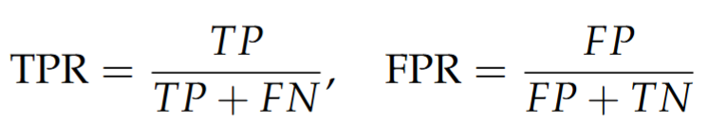
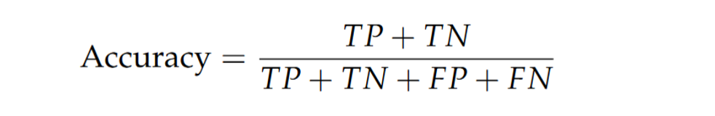
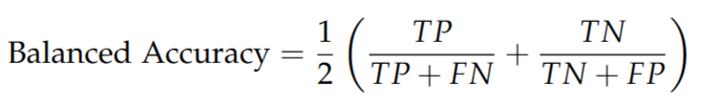
INTRODUCTION METHODOLOGY RESULTS CONCLUSIONS
Evaluation Protocol
Test Sets evaluated on CBIS-DDSM and BCDR partitions
Metrics:
Accuracy for overall correctness
Balanced Accuracy to counter class imbalance
ROC AUC for threshold-independent discrimination
Process: Predictions compared to ground truth; curves and confusion matrices generated for insight
Figure 19. Balanced accuracy calculation
Figure 20. ROC AUC calculation
Figure 18. Accuracy calculation
20/38

Slide 21
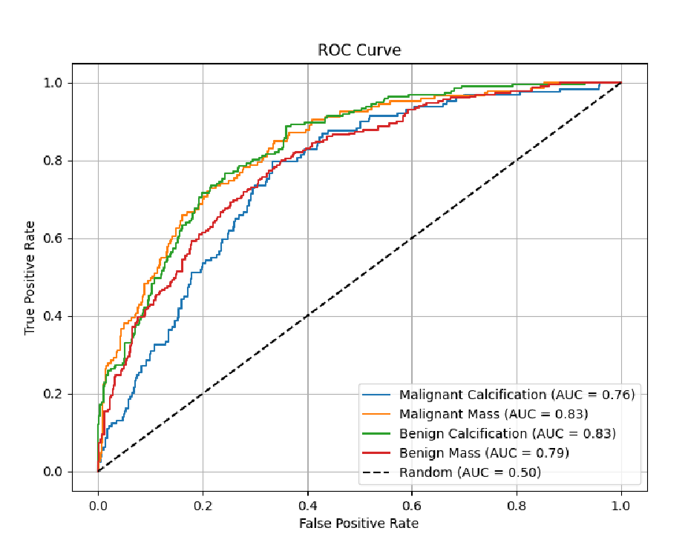
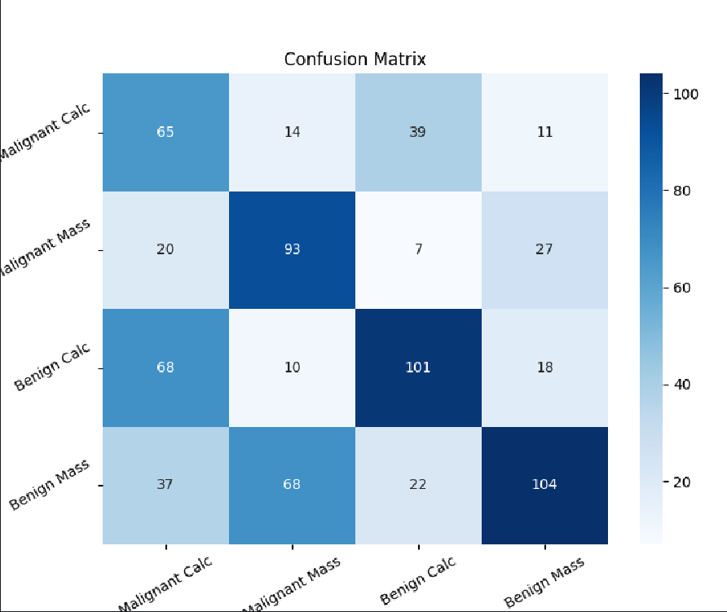
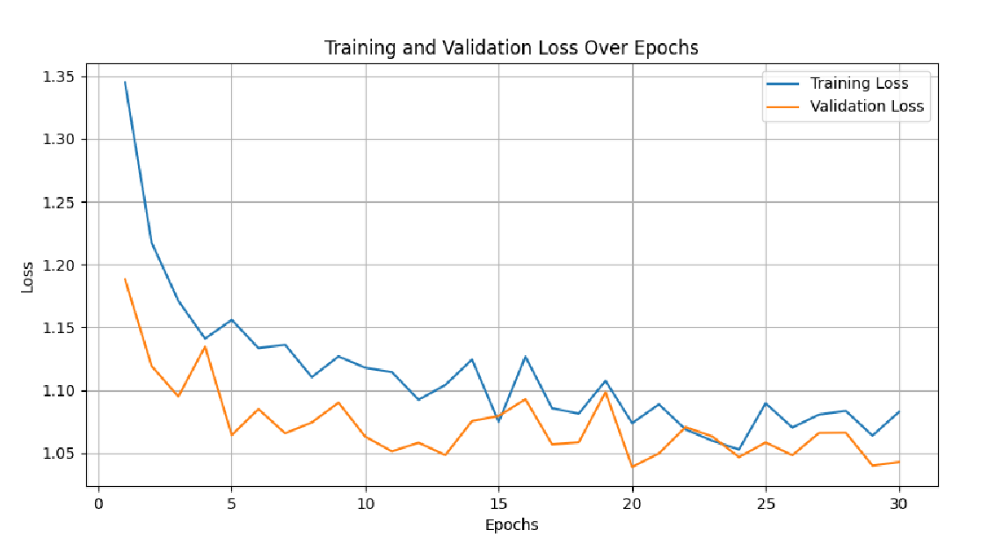
INTRODUCTION METHODOLOGY RESULTS CONCLUSIONS
In-Domain Performance (CBIS-DDSM & BCDR)
Figure 22. Confusion matrix
of best CBIS-DDSM in-domain multiclass experiment
Figure 23. ROC curves of best CBIS-DDSM in-domain multiclass experiment
Figure 21. Loss curves of best CBIS-DDSM in-domain multiclass experiment
21/38

Slide 22
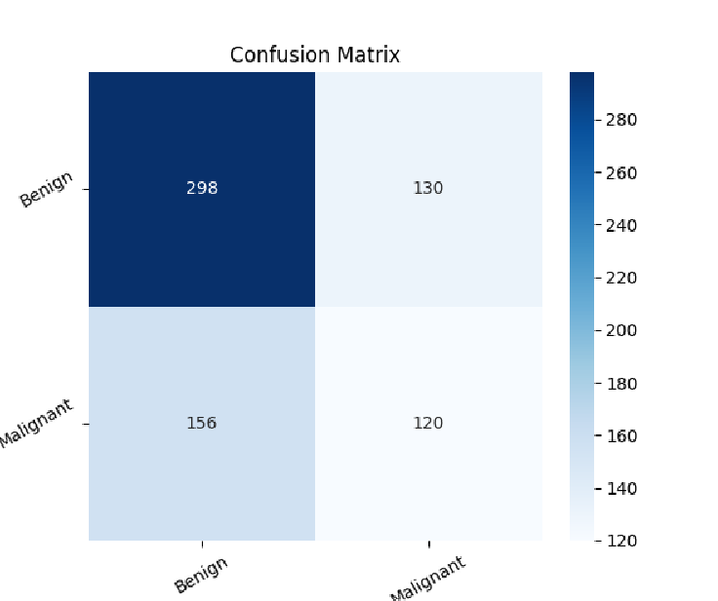
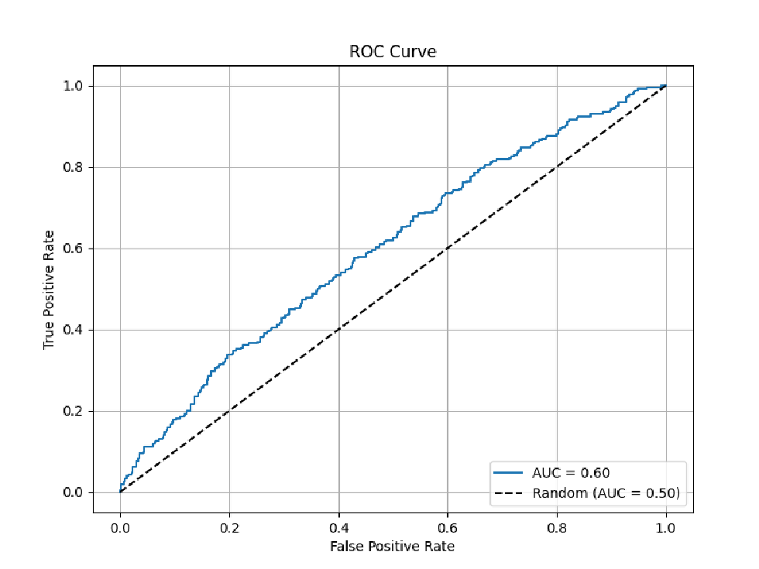
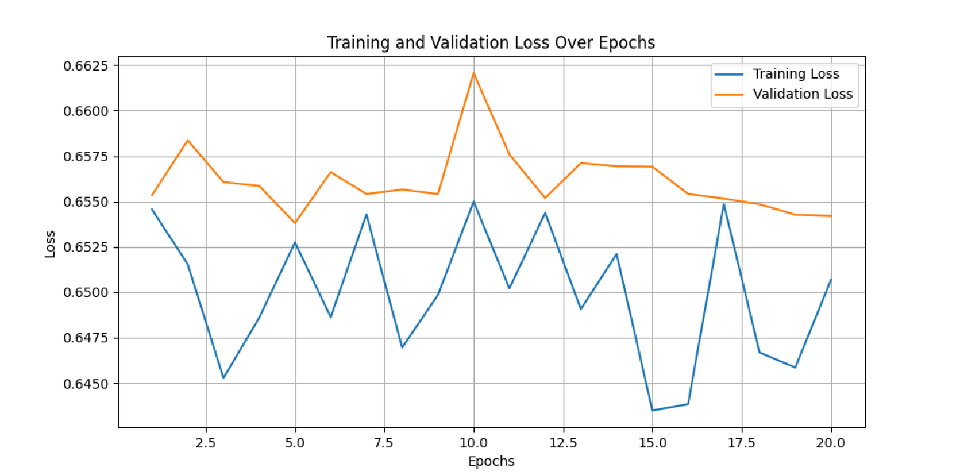
INTRODUCTION METHODOLOGY RESULTS CONCLUSIONS
In-Domain Performance (CBIS-DDSM & BCDR)
Figure 25. Confusion matrix
of best CBIS-DDSM in-domain binary experiment
Figure 26. ROC curve of best CBIS-DDSM in-domain binary experiment
Figure 24. Loss curves of best CBIS-DDSM in-domain binary experiment
22/38

Slide 23
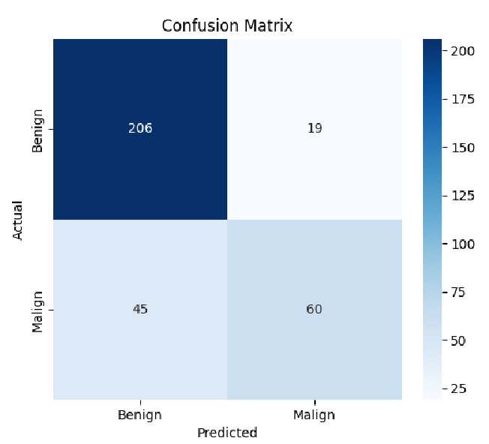
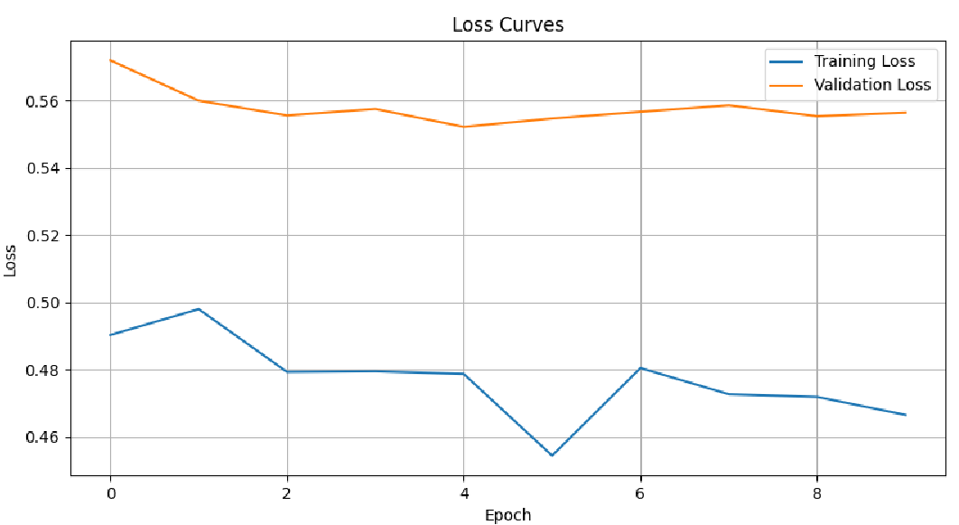
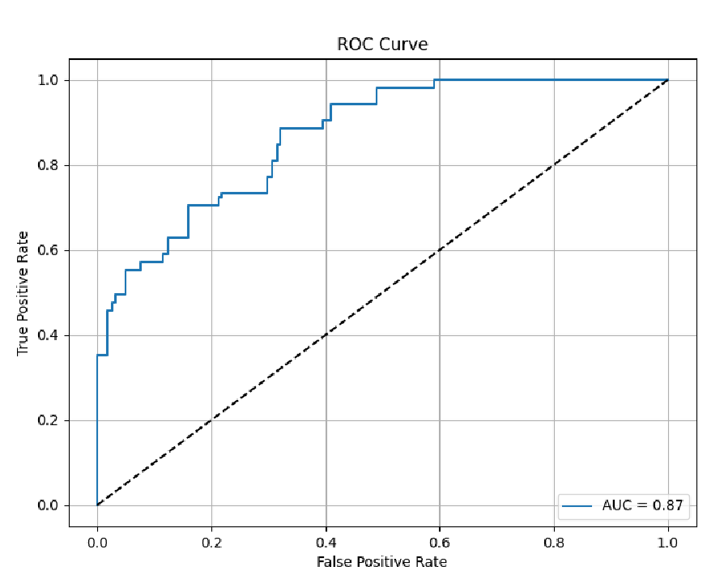
INTRODUCTION METHODOLOGY RESULTS CONCLUSIONS
In-Domain Performance (CBIS-DDSM & BCDR)
Figure 28. Confusion matrix
of best BCDR in-domain experiment
Figure 29. ROC curve of best BCDR in-domain experiment
Figure 27. Loss curves of best BCDR in-domain experiment
23/38

Slide 24
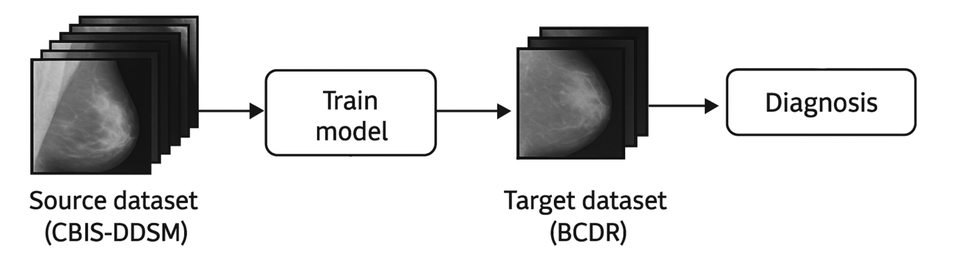
INTRODUCTION METHODOLOGY RESULTS CONCLUSIONS
Cross-Domain Transfer Results
Figure 30. First Cross-Domain experiment: Train on CBIS-DDSM and Test on BCDR
24/38

Slide 25
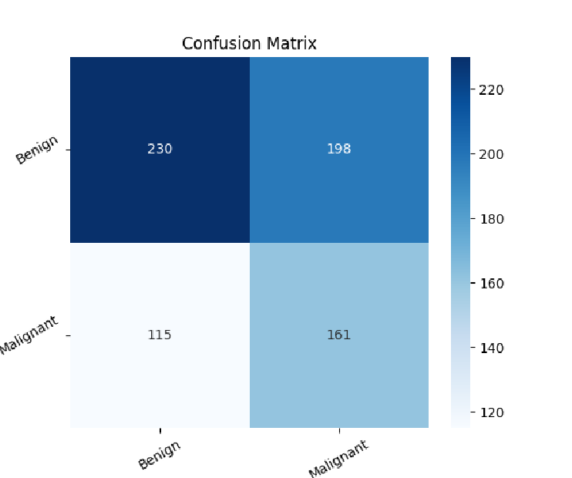
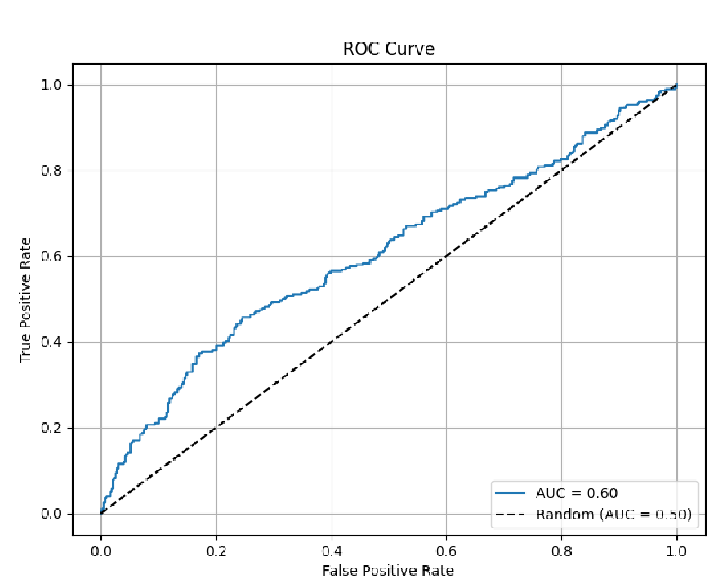
INTRODUCTION METHODOLOGY RESULTS CONCLUSIONS
Cross-Domain Transfer Resultsç
Figure 31. Confusion matrix
of best Train on BCDR, Test on CBIS-DDSM experiment
Figure 32. ROC curve of best Train on BCDR, Test on CBIS-DDSM experiment
25/38

Slide 26
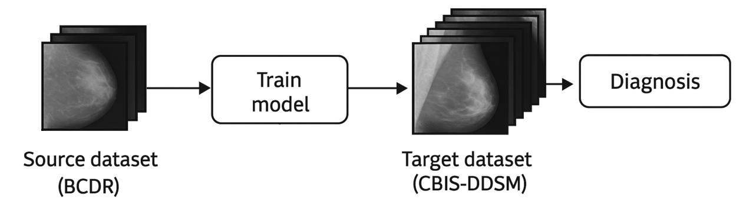
INTRODUCTION METHODOLOGY RESULTS CONCLUSIONS
Cross-Domain Transfer Results
Figure 33. Second Cross-Domain experiment: Train on BCDR and Test on CBIS-DDSM
26/38

Slide 27
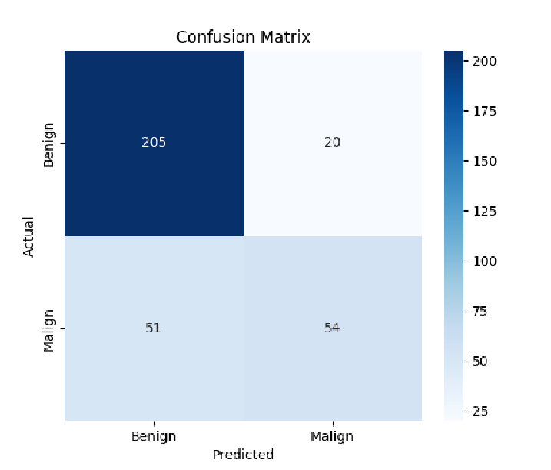
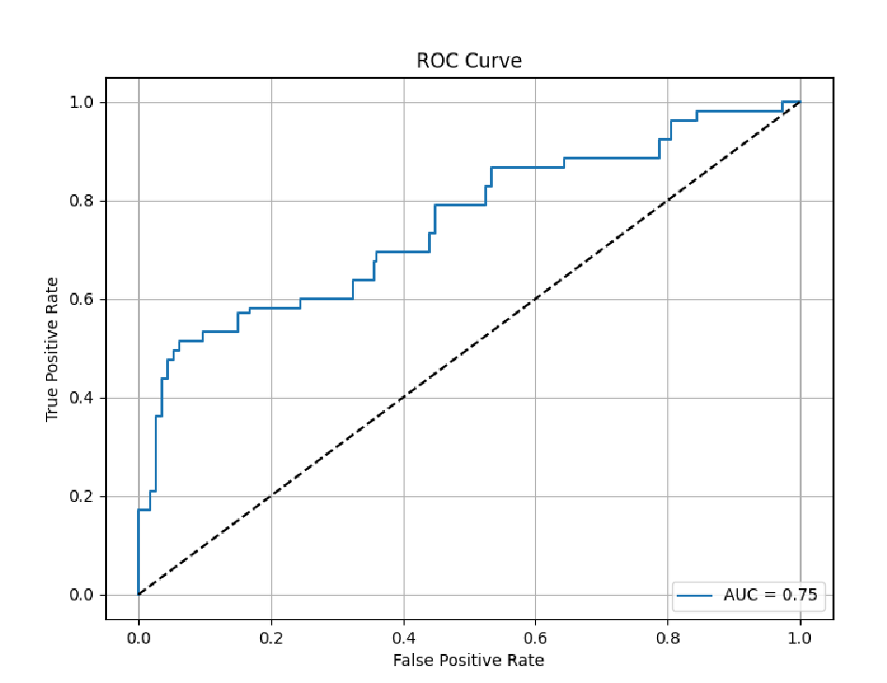
INTRODUCTION METHODOLOGY RESULTS CONCLUSIONS
Cross-Domain Transfer Results
Figure 34. Confusion matrix
of best Train on DDSM, Test on BCDR experiment
Figure 35. ROC curve of best Train on DDSM, Test on BCDR experiment
27/38

Slide 28
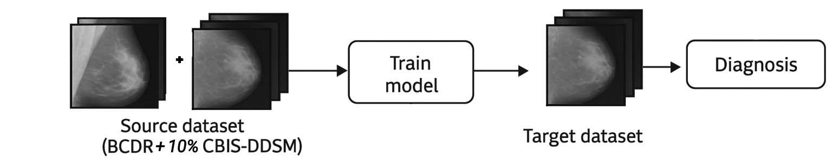
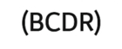
INTRODUCTION METHODOLOGY RESULTS CONCLUSIONS
Cross-Domain Transfer Results
Figure 36. Third Cross-Domain experiment: Train on BCDR + 10% of CBIS-DDSM and Test on BCDR
28/38

Slide 29
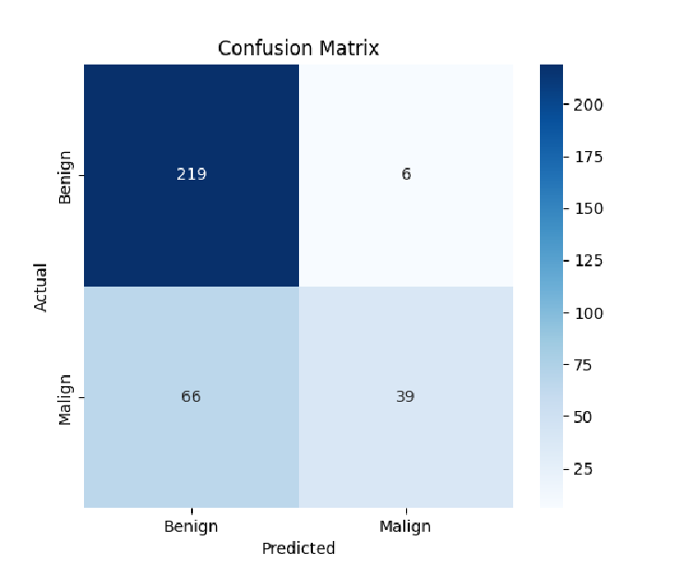
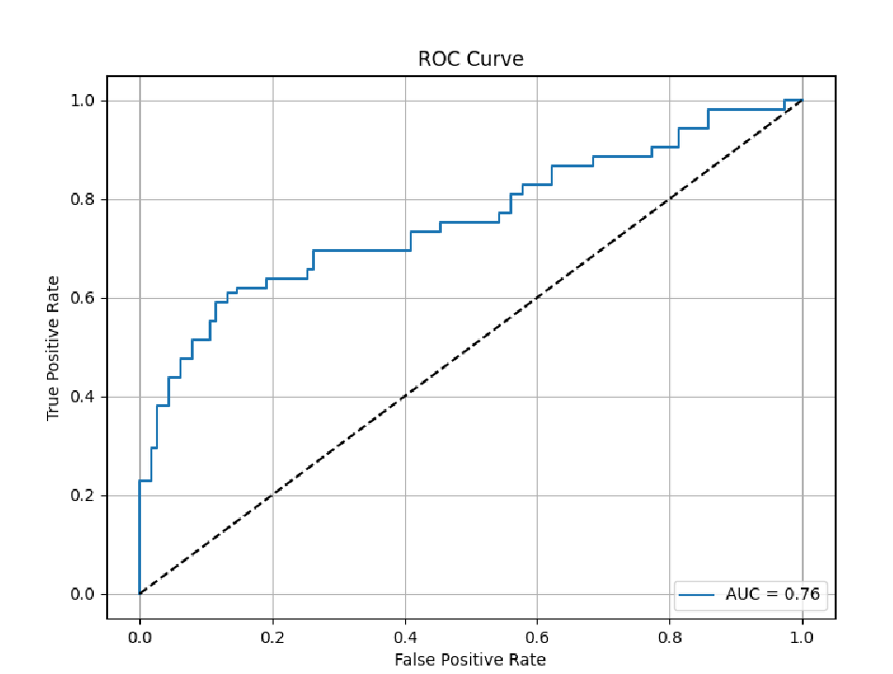
INTRODUCTION METHODOLOGY RESULTS CONCLUSIONS
Cross-Domain Transfer Results
Figure 38. Confusion matrix
of best Train on BCDR + 10% DDSM, Test on CBIS-DDSM experiment
Figure 38. ROC curve of best Train on BCDR + 10% DDSM, Test on CBIS-DDSM experiment
29/38

Slide 30
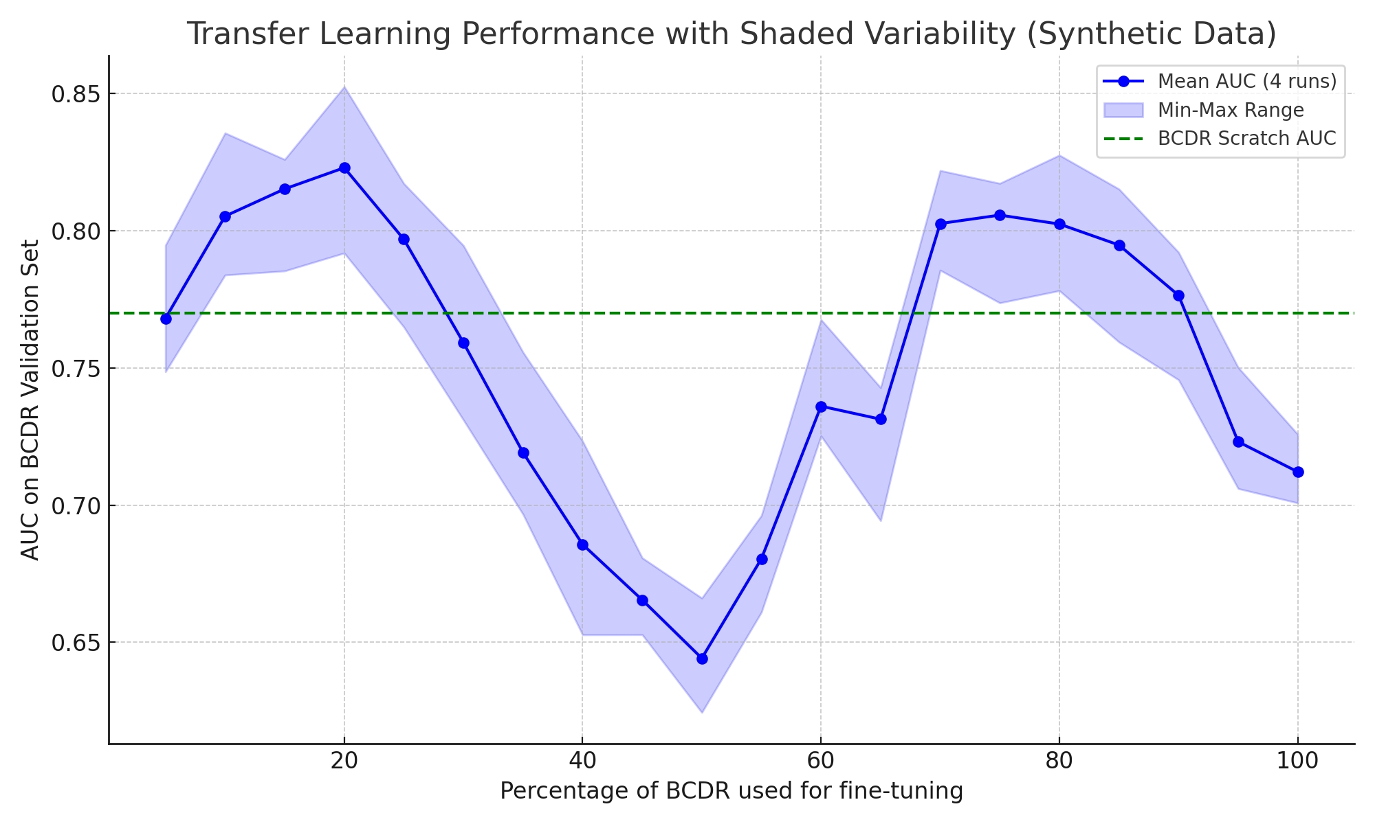
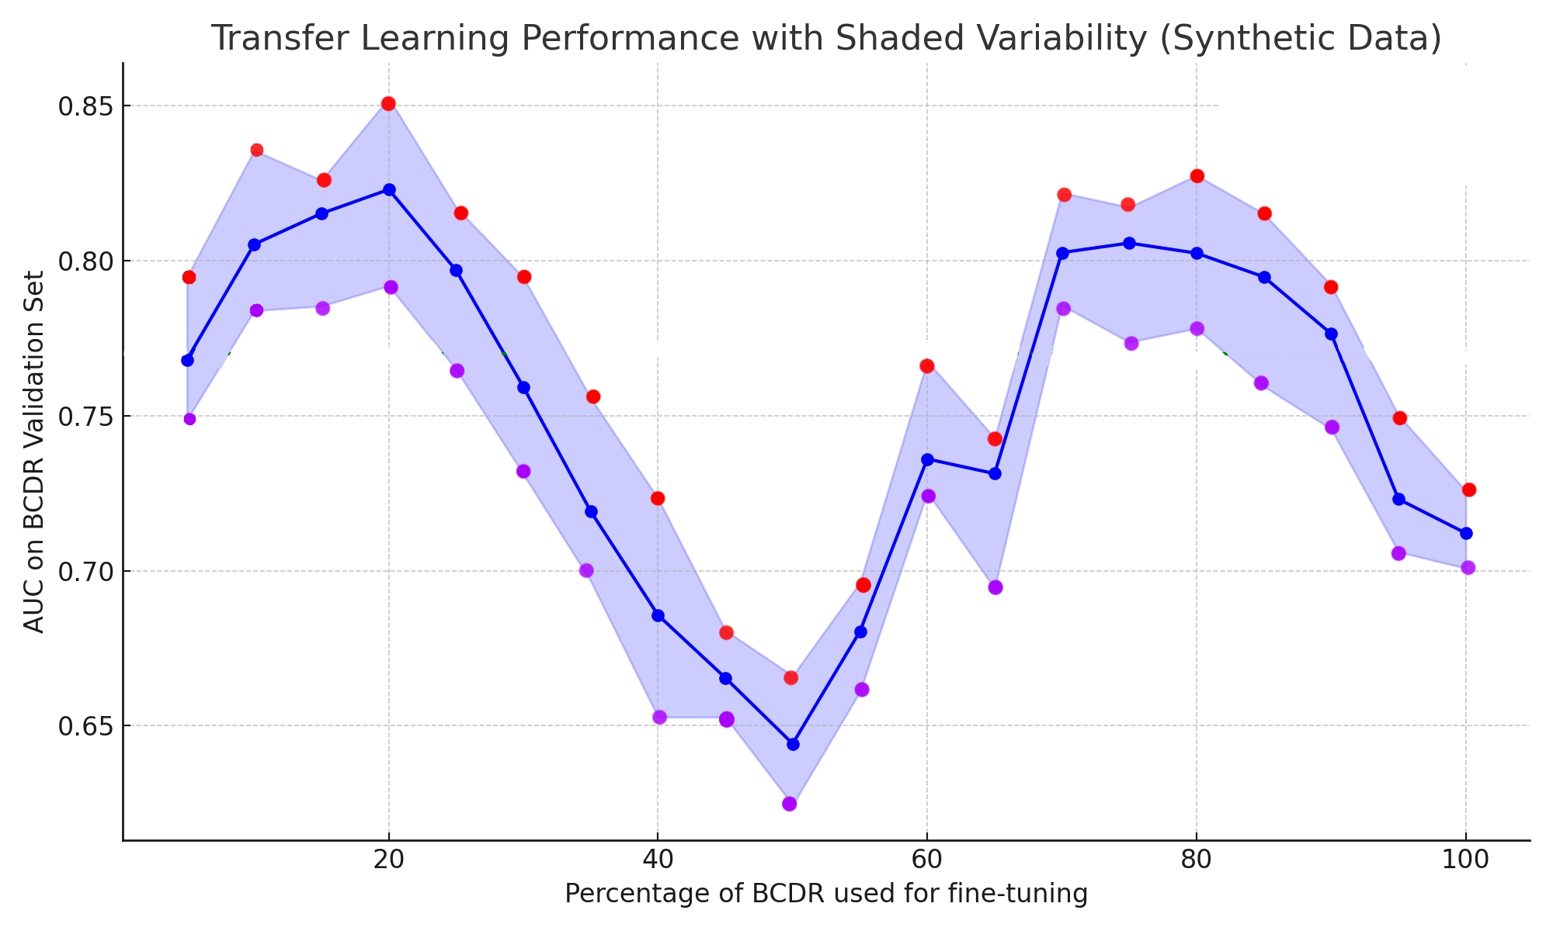
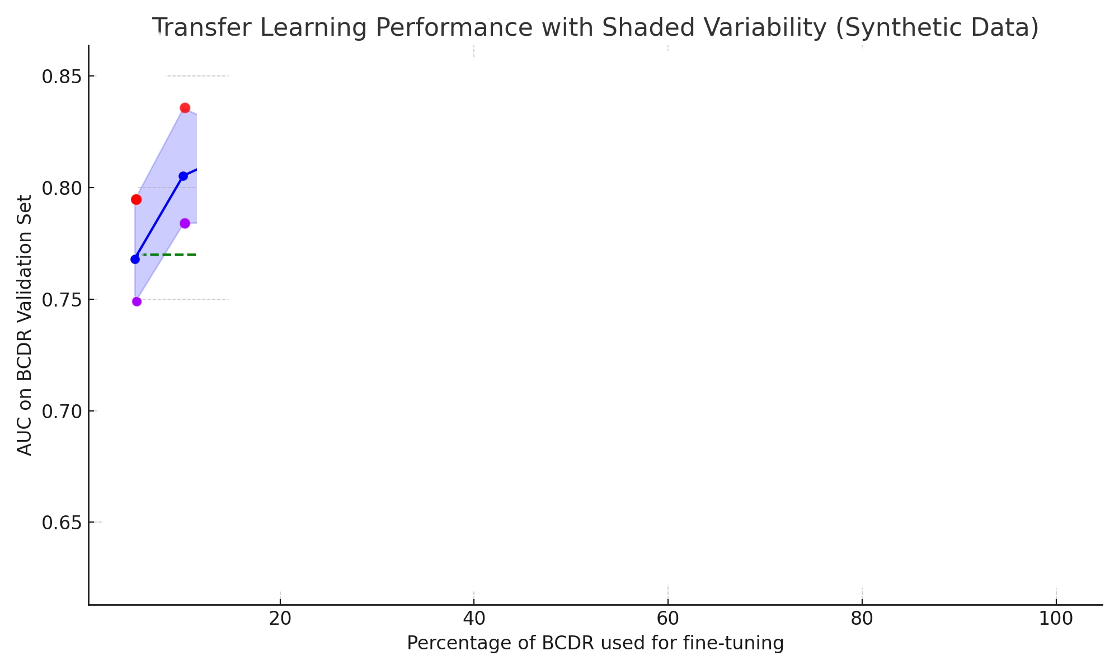
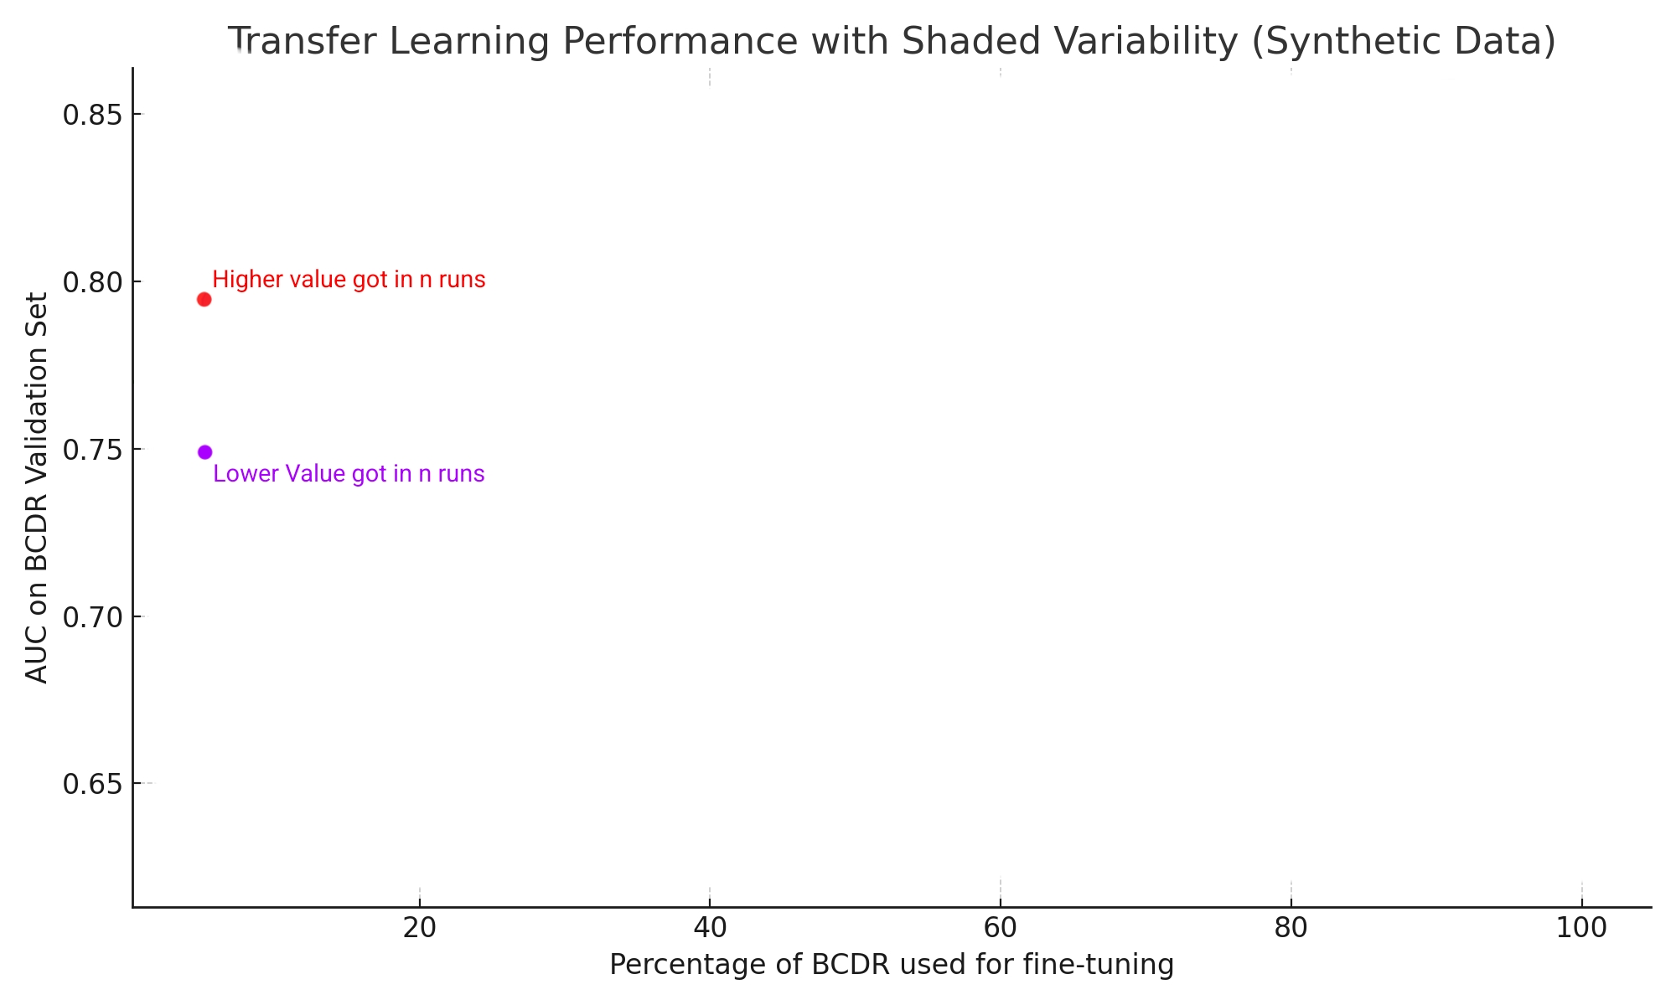






INTRODUCTION METHODOLOGY RESULTS CONCLUSIONS
Transfer Learning: Fine-tuning Curves
10%
5%
Figure 39. Fine tunning with different percentages explanation
30/38

Slide 31


INTRODUCTION METHODOLOGY RESULTS CONCLUSIONS
Transfer Learning: Fine-tuning Curves
Figure 41. Fine-tuning with BCDR Percentages on DDSM-trained Model with 2 runs second experiment
Figure 40. Fine-tuning with BCDR Percentages on DDSM-trained Model with 2 runs first experiment
31/38

Slide 32


INTRODUCTION METHODOLOGY RESULTS CONCLUSIONS
Transfer Learning: Fine-tuning Curves
Figure 43. Fine-tuning with BCDR Percentages on DDSM-trained Model with 4 runs second experiment
Figure 42. Fine-tuning with BCDR Percentages on DDSM-trained Model with 4 runs first experiment
32/38

Slide 33
INTRODUCTION METHODOLOGY RESULTS CONCLUSIONS
Summary
Designed and implemented a flexible ResNet-18–based classifier, featuring a frozen backbone and a tailored classification head
Validated in-domain robustness, achieving reliable discrimination within each dataset
Developed and executed a comprehensive cross-domain evaluation framework, including direct transfer and partial-data fine-tuning scenarios
Demonstrated efficient domain adaptation, showing that minimal target-domain samples suffice to align performance with full retraining
33/38

Slide 34
INTRODUCTION METHODOLOGY RESULTS CONCLUSIONS
Observations
In-domain training on BCDR achieved strong discrimination (AUC ≈ 0.87), while CBIS-DDSM in-domain AUC plateaued around 0.60.
Direct cross-domain transfer yielded modest performance (AUC ~0.60–0.72), highlighting domain shift impact.
Fine-tuning with as little as 30–40 % of target data recovered or surpassed scratch-trained performance, demonstrating efficient transfer learning.
Frozen backbone + lightweight head reduced overfitting and accelerated convergence, but limited representation adaptation.
34/38

Slide 35
INTRODUCTION METHODOLOGY RESULTS CONCLUSIONS
Limitations
CBIS-DDSM and BCDR vary significantly in modality and quality.
Persistent label imbalance in both datasets not fully addressed by sampling or loss weighting.
Long CPU runtimes (≥ 27 h) required SSH access to GPU nodes; still limited hyperparameter search and ensemble experiments.
BCDR’s smaller size and restricted access reduced statistical power in transfer analyses.
35/38

Slide 36


INTRODUCTION METHODOLOGY RESULTS CONCLUSIONS
Future Work Ideas
Explore self-supervised contrastive pre-training on unlabeled mammograms to learn robust, domain-agnostic feature embeddings [10]
Investigate Vision Transformer architectures for enhanced global context modeling and improved cross-domain generalization in breast cancer classification [11]
Figure 44. Contrastive pretraining diagram [10]
Figure 45. Vision transformers diagram [11]
36/38

Slide 37
INTRODUCTION METHODOLOGY RESULTS CONCLUSIONS
Webgraphy
[9] Nikam, J., Nankar, G., Liddad, A., Yeole, L., & Pawar, S. (2024). Artificial Intelligence in Female Cancers Screening, Diagnosis and Treatment. International Journal of Pharmaceutical Research and Applications, 9(4), 692–714. https://ijprajournal.com/issue_dcp/Artificial%20Intelligence%20in%20Female%20Cancers%20Screening,%20Diagnosis%20and%20Treatment.pdf
[10] Kundu, R. (2022, May 22). The Beginner’s Guide to Contrastive Learning. V7 Labs. [Online]. Available: https://www.v7labs.com/blog/contrastive-learning-guide
[11] Papers With Code. “Vision Transformer Explained.” Papers With Code, n.d. [Online]. Available: https://paperswithcode.com/method/vision-transformer
[12] American Cancer Society. “Survival Rates for Breast Cancer.” American Cancer Society, Jan. 2025. [Online]. Available: https://www.cancer.org/cancer/types/breast-cancer/understanding-a-breast-cancer-diagnosis/breast-cancer-survival-rates.html
[13] Ibrahim, M., Henna, S., Cullen, G., Jennings, B., & Butler, B. (2022). Multi-Graph Convolutional Neural Network for Breast Cancer Multi-Task Classification. ResearchGate. [Online]. Available: https://www.researchgate.net/figure/Calcification-and-mass-abnormalities-in-breast-mammogram-scans-The-calcification_fig1_359430128:contentReference[oaicite:4]{index=4}
[5] Doctor Anywhere. “Mammogram vs. Ultrasound: Which Breast Cancer Screening is Right for You?” Doctor Anywhere, Oct. 8, 2024. [Online]. Available: https://doctoranywhere.com/blog/2024/10/08/mammogram-vs-ultrasound-which-breast-cancer-screening-is-right-for-you/
[6] MagView. “Breast MRI for Cancer Risk: Benefits & Types of Screenings.” MagView, Jun. 16, 2021. [Online]. Available: https://magview.com/blog/breast-mri-high-risk-patients/Fonts
[7] Medical Technology Management Institute (MTMI). “Essentials for Standard Projections – CC and MLO Views.” MTMI, Sept. 25, 2025. [Online]. Available: https://www.mtmi.net/webinar/essentials-standard-projections-cc-and-mlo-views
[8] Martínez Saíd, H. “Cáncer de Mama.” Alta Especialidad en Cáncer, n.d. [Online]. Available: https://www.altaespecialidadencancer.com/cancer-de-mama
[1] Bray, F. I., Ferlay, J., Soerjomataram, I., Siegel, R. L., Torre, L. A., & Jemal, A. (2018). Global cancer statistics 2018: GLOBOCAN estimates of incidence and mortality worldwide for 36 cancers in 185 countries. CA: A Cancer Journal for Clinicians, 68(6), 394–424. https://doi.org/10.3322/caac.21492
[2] Sociedad Española de Oncología Médica (SEOM). Cancer incidence estimates in Spain in 2022. SEOM, Sep. 29, 2023. [Online]. Available: https://seom.org/100252-Sala%20de%20Prensa/el-cancer-en-espanacom/210171-estimaciones-incidencia-2022
[3] M. Weiss, “Breast Cancer Checks: From Self-Exams to Screening Tests,” Verywell Health, Jun. 26, 2025. [Online]. Available: https://www.verywellhealth.com/breast-cancer-testing-screening-5204528
[4] Xplore Radiology. “What Is Breast Tomosynthesis and Is It Better than Mammography?” Xplore Radiology, n.d. [Online]. Available: https://xploreradiology.com.au/what-is-breast-tomosynthesis-and-is-it-better-than-mammography/
38/38

Slide 38
Domain Adaptation in Breast Cancer Classification
Autor: Christian Queralt Aixendri
Director: Dr. Kaisar Kushibar
Developed in: Mathematics and Computer Science department

